Slide 1

Dynamic Playlist Management in Music Streaming Applications Using Data Structures
Efficient Playlist Operations Using Doubly Linked Lists
Presented by: M. VAISHNAV — Roll No: 192524251 — Dept. of Artificial Intelligence and Data Science, SIMATS Engineering

Slide 2

Introduction — Why playlist performance matters
Streaming services manage large libraries and millions of user playlists. Users expect instant responses when they add, remove, or reorder tracks. The playlist back-end must provide low-latency operations while supporting features like skip, repeat, and history.
Problem statement
Support dynamic insertion of tracks at arbitrary positions
Allow deletion with minimal overhead
Enable reordering and moves with constant-time updates
Provide fast Next / Previous navigation for playback
Scale efficiently for very long playlists

Slide 3
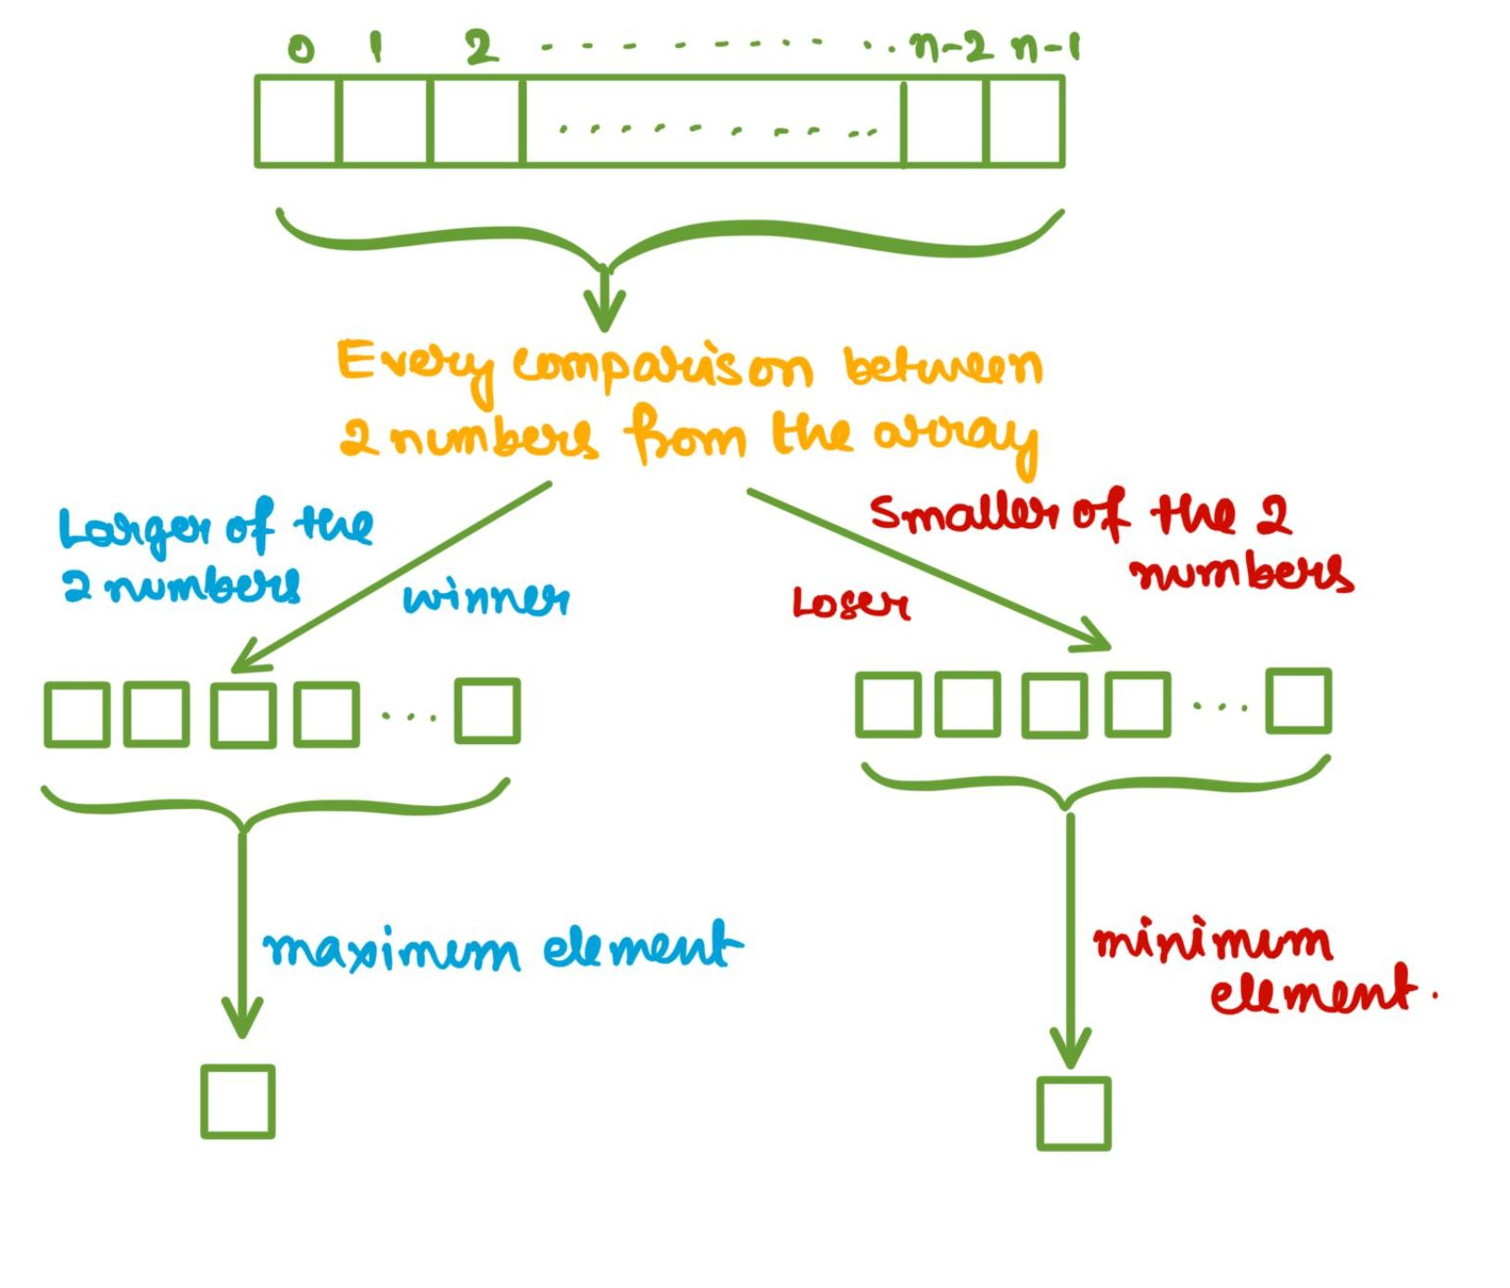
Data Structure Candidates
Array
Pros: O(1) random access, compact memory layout. Cons: insertion/deletion require shifting elements — O(n) worst-case; expensive for frequent edits.
Singly Linked List
Pros: O(1) insertion at known node, low-cost node allocation. Cons: no backward traversal, deletion requires pointer to previous node or O(n) search.
Doubly Linked List
Pros: O(1) insertion & deletion given node reference, forward and backward traversal, ideal for player Next/Previous and efficient reordering. Slightly higher memory (extra pointer) but better operational fit for playlists.

Slide 4
Recommended Structure — Doubly Linked List
Each playlist node stores: previous pointer, song metadata (id, title, artist, duration, URI), and next pointer. The list supports head/tail references and optional hashing (index map) for O(1) lookup of nodes by song id.
Node contents
Auxiliary structures
Playlist features
Prev pointer · Song data · Next pointer
Hash map: songId → node (optional) for direct access
Skip, repeat, move-to-front, remove, insert-after, insert-before

Slide 5



Why Doubly Linked Lists Win
Bi-directional navigation
Constant-time edits
Integrates with sync & caching
Native support for Next and Previous playback without extra state.
Insert, remove, and move require only pointer updates when node reference known.
Works well with diffs, CRDTs, and server-side persistence for large-scale apps.

Slide 6

Conclusion & Recommendation
Doubly linked lists provide the best balance of efficiency, flexibility, and straightforward implementation for dynamic playlist management in music streaming apps. When combined with an optional songId→node map and a compact sync log, they deliver O(1) runtime edits and robust cross-device behavior.
Final recommendation: Implement an in-memory doubly linked list for runtime playlist operations, augment with an index map for direct access, and integrate a lightweight event log for synchronization and durability.
Thank you

